Slide 1

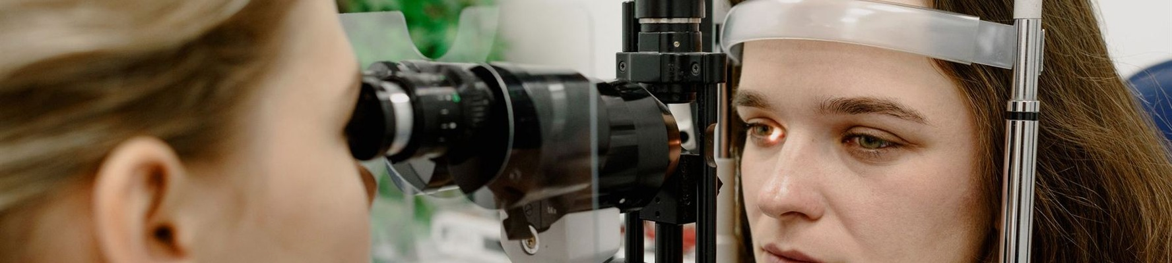

EYE HEALTH
Dry, gritty eyes after
a day at the screen?
Blink more, look 20 feet away every 20 minutes, and ask us about dry eye therapy if drops stop helping.
ASK US AT YOUR NEXT VISIT
Notes:
Education (paper). Tips, condition explainers, FAQ answers. Swap or delete the photo band; keep one amber element (the rule). Chip is optional.

Slide 2

FOLSOM OFFICE
Early Friday hours,
6:30am to 2:00pm
Fit your exam in before work. Free parking at the door.
CALL FOLSOM
916-983-9823
EYESITEMD.COM
Notes:
Announcement (navy). Hours, closures, new services. Keep the phone number of the office concerned in the serif.

Slide 3

SACRAMENTO AND FOLSOM
Caring for Sacramento’s
eyes since 1987
Five board-certified ophthalmologists and two optometrists, two offices, free parking at both.
NEW PATIENTS WELCOME
EYESITEMD.COM
Notes:
Photo. Team news, awards, office photos. Replace the photograph; the navy overlay stays on top so white text always reads.

Slide 4


“
Paste the patient’s review here, word for word, once they have given permission to share it. Keep it under about 40 words so it stays large.
First name, City · Google review
EYESITEMD.COM
Notes:
Review (ice). Quote real reviews with permission, under about 40 words. Stars are the one amber element.

Slide 5
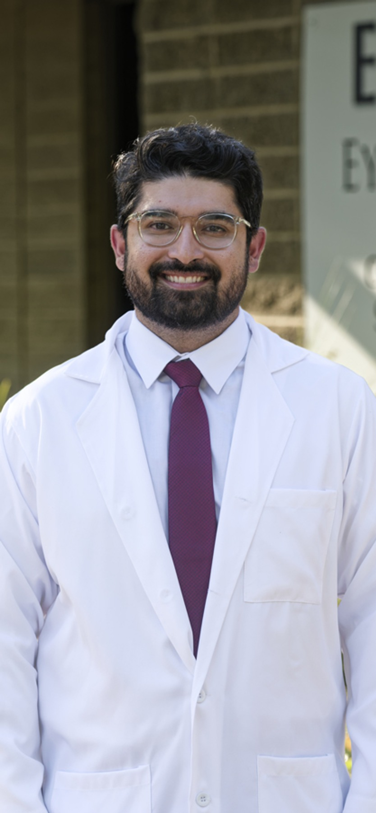

MEET THE DOCTORS
Dr. Rashidi
CORNEA SPECIALIST
Team ophthalmologist for the Sacramento Kings
Confirm wording and source before posting
NEW PATIENTS WELCOME
EYESITEMD.COM
Notes:
Doctor spotlight. Replace the portrait (at least 1200px tall), name, role and one sourced accolade.

Slide 6

CATARACT SURGERY
What happens at
a cataract consult
Four steps, one visit. Swipe through.
SWIPE
Notes:
Carousel cover (navy). Page 1 of a multi-slide explainer; the logo appears here only.

Slide 7

CATARACT SURGERY
01 / 04
01
A dilated exam
Drops widen your pupils so the doctor can see the lens and the retina behind it. Plan for blurry near vision for a few hours afterward.
EYESITEMD.COM
Dr. [name] reviewed this
Notes:
Carousel slide. Duplicate per step; update the number, counter and progress bar.

